Slide 1
FIT1055: IT professional practice and Ethics
Introduction to Ethical Reasoning Framework
Part 4- Design user-centered mockups
FIT1055: IT Professional Practice and Ethics | Week 9

Slide 2
Learning outcomes at the end of this week
Comprehend why mockup/prototype design can be an effective tool for communicating your ideas
Synthesize how to make use of the Figma design tool as a tool for the effective communication of your ideas
Translate Step 3 ethical pseudocode into tangible interface designs that embed ethical safeguards
FIT1055: IT Professional Practice and Ethics | Week 9
Notes:
The professional practices course was developed to address difficulties with soft topic coverage in the degree plan used for many years, along with increased needs that arose from broadening the available degree programs and heightened expectations for computing curricula. Throughout the 80's and 90's, the CSE department offered a single undergraduate degree in Computer Science and Engineering. The first year of the program included a one-hour college-level common course (1104) Introduction to Engineering to provide exposure to the diversity of challenges in engineering, along with another one-hour departmental course (1105) Introduction to Computer Science and Engineering to address further topics on responsibilities and expectations for students in computing. The two-semester capstone senior design sequence (4316/4317) emphasizes an extended design experience in a team setting, but had the additional responsibility for delivering substantial knowledge and assessing student achievement on nontechnical student outcomes. This situation often led to uneven coverage of the non-technical topics from semester to semester depending upon the instructor. Students also found it very challenging to balance between learning the technical topics and soft topics simultaneously. The topics covered in the professional practices course provide a just-in-time coverage of the topics most needed at this stage, and was the primary motivation for offering this class. The new course was also needed to strengthen compliance with ABET criteria as discussed below. In 2003, additional programs in Computer Science and Software Engineering were accredited through CAC and EAC, respectively. After a re-accreditation visit for all three programs in 2006, the Computer Science and Engineering program was renamed to Computer Engineering. Like all ABET accredited programs, each of the three programs has a list of educational objectives (PEOs). These can be found on the departmental website http://cse.uta.edu/ but may be summarized as follows: 1. Initial employment 2. Advance in responsibilities 3. Demonstrate leadership The PEOs are mapped to student learning outcomes and the three degree plans in the following systematic fashion. PEO 1 regards fundamentals indispensable in any effort involving computing in the few years following graduation. PEO 2 regards broader design and teamwork responsibilities. PEO 3 includes attitudes, values, and altruism as a seasoned computing professional of the broadest perspective. When viewed this way, PEO 3 involves the following EAC and CAC student outcomes.
What characteristics should a professional exhibit?
Professional bodies each have their own ideas of the characteristics that their members should possess to be considered "a professional". These are stated in their codes of conduct and ethics and all of the bodies have their own versions of these. Certain items appear in all of them including:
keeping up to date with the field
helping their colleagues advance within their field
showing concern for the well being of their clients
adhering to the relevant legislation
respecting client confidentiality
we can see that a professional:
is engaged in one of the learned professions
has a calling requiring specialized knowledge and often long and intensive academic preparation
is characterized by or conforming to the technical or ethical standards of a profession
So professionals spend a long time studying a particular calling

Slide 3
This week, we will look at Step 3
Step 1 - Analyze and Define
Evaluate ACM Code of Ethics violations and define stakeholders’ impact
Step 2 – Design solutions using Design Thinking
Create solutions addressing violations
Step 3 - Implement: Apply ethical system theories in code
Step 4- Visualize: Design user-centered mockups
FIT1055: IT Professional Practice and Ethics | Week 9

Slide 4
Introduction to mockups and prototyping
FIT1055: IT Professional Practice and Ethics | Week 9
Notes:
The professional practices course was developed to address difficulties with soft topic coverage in the degree plan used for many years, along with increased needs that arose from broadening the available degree programs and heightened expectations for computing curricula. Throughout the 80's and 90's, the CSE department offered a single undergraduate degree in Computer Science and Engineering. The first year of the program included a one-hour college-level common course (1104) Introduction to Engineering to provide exposure to the diversity of challenges in engineering, along with another one-hour departmental course (1105) Introduction to Computer Science and Engineering to address further topics on responsibilities and expectations for students in computing. The two-semester capstone senior design sequence (4316/4317) emphasizes an extended design experience in a team setting, but had the additional responsibility for delivering substantial knowledge and assessing student achievement on nontechnical student outcomes. This situation often led to uneven coverage of the non-technical topics from semester to semester depending upon the instructor. Students also found it very challenging to balance between learning the technical topics and soft topics simultaneously. The topics covered in the professional practices course provide a just-in-time coverage of the topics most needed at this stage, and was the primary motivation for offering this class. The new course was also needed to strengthen compliance with ABET criteria as discussed below. In 2003, additional programs in Computer Science and Software Engineering were accredited through CAC and EAC, respectively. After a re-accreditation visit for all three programs in 2006, the Computer Science and Engineering program was renamed to Computer Engineering. Like all ABET accredited programs, each of the three programs has a list of educational objectives (PEOs). These can be found on the departmental website http://cse.uta.edu/ but may be summarized as follows: 1. Initial employment 2. Advance in responsibilities 3. Demonstrate leadership The PEOs are mapped to student learning outcomes and the three degree plans in the following systematic fashion. PEO 1 regards fundamentals indispensable in any effort involving computing in the few years following graduation. PEO 2 regards broader design and teamwork responsibilities. PEO 3 includes attitudes, values, and altruism as a seasoned computing professional of the broadest perspective. When viewed this way, PEO 3 involves the following EAC and CAC student outcomes.
What characteristics should a professional exhibit?
Professional bodies each have their own ideas of the characteristics that their members should possess to be considered "a professional". These are stated in their codes of conduct and ethics and all of the bodies have their own versions of these. Certain items appear in all of them including:
keeping up to date with the field
helping their colleagues advance within their field
showing concern for the well being of their clients
adhering to the relevant legislation
respecting client confidentiality
we can see that a professional:
is engaged in one of the learned professions
has a calling requiring specialized knowledge and often long and intensive academic preparation
is characterized by or conforming to the technical or ethical standards of a profession
So professionals spend a long time studying a particular calling

Slide 5
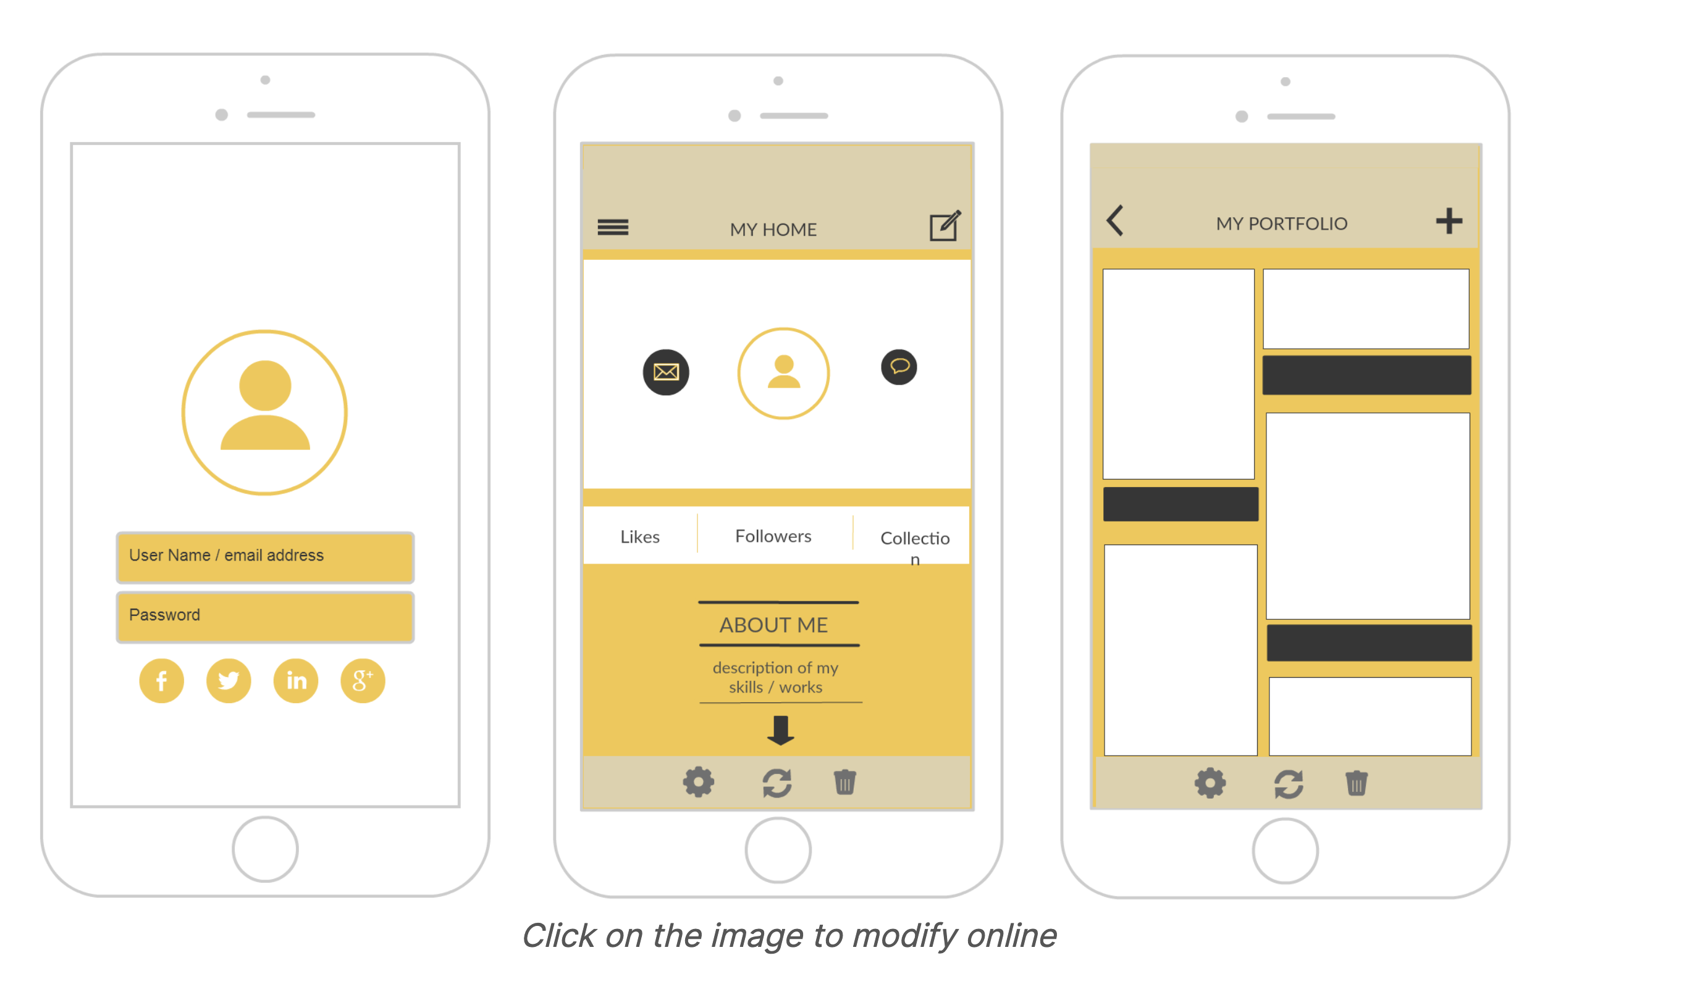
What is a mockup?
Detailed visual representation/model of a product or design
Static yet realistic preview of final product
Not fully functional but visually complete
Both are used interchangeably
Mockup and prototype
FIT1055: IT Professional Practice and Ethics | Week 9
Notes:
The professional practices course was developed to address difficulties with soft topic coverage in the degree plan used for many years, along with increased needs that arose from broadening the available degree programs and heightened expectations for computing curricula. Throughout the 80's and 90's, the CSE department offered a single undergraduate degree in Computer Science and Engineering. The first year of the program included a one-hour college-level common course (1104) Introduction to Engineering to provide exposure to the diversity of challenges in engineering, along with another one-hour departmental course (1105) Introduction to Computer Science and Engineering to address further topics on responsibilities and expectations for students in computing. The two-semester capstone senior design sequence (4316/4317) emphasizes an extended design experience in a team setting, but had the additional responsibility for delivering substantial knowledge and assessing student achievement on nontechnical student outcomes. This situation often led to uneven coverage of the non-technical topics from semester to semester depending upon the instructor. Students also found it very challenging to balance between learning the technical topics and soft topics simultaneously. The topics covered in the professional practices course provide a just-in-time coverage of the topics most needed at this stage, and was the primary motivation for offering this class. The new course was also needed to strengthen compliance with ABET criteria as discussed below. In 2003, additional programs in Computer Science and Software Engineering were accredited through CAC and EAC, respectively. After a re-accreditation visit for all three programs in 2006, the Computer Science and Engineering program was renamed to Computer Engineering. Like all ABET accredited programs, each of the three programs has a list of educational objectives (PEOs). These can be found on the departmental website http://cse.uta.edu/ but may be summarized as follows: 1. Initial employment 2. Advance in responsibilities 3. Demonstrate leadership The PEOs are mapped to student learning outcomes and the three degree plans in the following systematic fashion. PEO 1 regards fundamentals indispensable in any effort involving computing in the few years following graduation. PEO 2 regards broader design and teamwork responsibilities. PEO 3 includes attitudes, values, and altruism as a seasoned computing professional of the broadest perspective. When viewed this way, PEO 3 involves the following EAC and CAC student outcomes.
What characteristics should a professional exhibit?
Professional bodies each have their own ideas of the characteristics that their members should possess to be considered "a professional". These are stated in their codes of conduct and ethics and all of the bodies have their own versions of these. Certain items appear in all of them including:
keeping up to date with the field
helping their colleagues advance within their field
showing concern for the well being of their clients
adhering to the relevant legislation
respecting client confidentiality
we can see that a professional:
is engaged in one of the learned professions
has a calling requiring specialized knowledge and often long and intensive academic preparation
is characterized by or conforming to the technical or ethical standards of a profession
So professionals spend a long time studying a particular calling

Slide 6

When do we use mockups?
Software: Visualize UI/UX before coding
Products: Present concepts, evaluate ergonomics/aesthetics
Improve communication between teams
Connect developers, designers, and stakeholders
FIT1055: IT Professional Practice and Ethics | Week 9

Slide 7
Types of mockups
Can be digital or physical
Range from simple sketches to detailed prototypes
FIT1055: IT Professional Practice and Ethics | Week 9

Slide 8
Advantages
Cost efficiency: Avoid expensive late-stage changes
Clear communication between teams and stakeholders
Early problem detection
Accelerated decision-making
Gather user feedback sooner
Flexibility to explore alternatives quickly
FIT1055: IT Professional Practice and Ethics | Week 9

Slide 9
Used as a pitching tool of ideas
Investors need more than bottom-line figures—they need to be wowed
Without mockups, even brilliant ideas remain abstract concepts
Well-crafted visual pitches provide a "crystal ball" glimpse of future success
Design assets demonstrate clarity of vision in your business case
Polished, realistic mockups inspire investor confidence
High-quality prototypes boost credibility as an execution-capable professional
FIT1055: IT Professional Practice and Ethics | Week 9

Slide 10

What is Prototyping?
Prototyping is therefore defined as an experimental process where design teams implement ideas into tangible forms, from paper to digital.
FIT1055: IT Professional Practice and Ethics | Week 9
Notes:
The professional practices course was developed to address difficulties with soft topic coverage in the degree plan used for many years, along with increased needs that arose from broadening the available degree programs and heightened expectations for computing curricula. Throughout the 80's and 90's, the CSE department offered a single undergraduate degree in Computer Science and Engineering. The first year of the program included a one-hour college-level common course (1104) Introduction to Engineering to provide exposure to the diversity of challenges in engineering, along with another one-hour departmental course (1105) Introduction to Computer Science and Engineering to address further topics on responsibilities and expectations for students in computing. The two-semester capstone senior design sequence (4316/4317) emphasizes an extended design experience in a team setting, but had the additional responsibility for delivering substantial knowledge and assessing student achievement on nontechnical student outcomes. This situation often led to uneven coverage of the non-technical topics from semester to semester depending upon the instructor. Students also found it very challenging to balance between learning the technical topics and soft topics simultaneously. The topics covered in the professional practices course provide a just-in-time coverage of the topics most needed at this stage, and was the primary motivation for offering this class. The new course was also needed to strengthen compliance with ABET criteria as discussed below. In 2003, additional programs in Computer Science and Software Engineering were accredited through CAC and EAC, respectively. After a re-accreditation visit for all three programs in 2006, the Computer Science and Engineering program was renamed to Computer Engineering. Like all ABET accredited programs, each of the three programs has a list of educational objectives (PEOs). These can be found on the departmental website http://cse.uta.edu/ but may be summarized as follows: 1. Initial employment 2. Advance in responsibilities 3. Demonstrate leadership The PEOs are mapped to student learning outcomes and the three degree plans in the following systematic fashion. PEO 1 regards fundamentals indispensable in any effort involving computing in the few years following graduation. PEO 2 regards broader design and teamwork responsibilities. PEO 3 includes attitudes, values, and altruism as a seasoned computing professional of the broadest perspective. When viewed this way, PEO 3 involves the following EAC and CAC student outcomes.
What characteristics should a professional exhibit?
Professional bodies each have their own ideas of the characteristics that their members should possess to be considered "a professional". These are stated in their codes of conduct and ethics and all of the bodies have their own versions of these. Certain items appear in all of them including:
keeping up to date with the field
helping their colleagues advance within their field
showing concern for the well being of their clients
adhering to the relevant legislation
respecting client confidentiality
we can see that a professional:
is engaged in one of the learned professions
has a calling requiring specialized knowledge and often long and intensive academic preparation
is characterized by or conforming to the technical or ethical standards of a profession
So professionals spend a long time studying a particular calling

Slide 11
Two types of prototype
Low fidelity
A low-fidelity prototype represents a simple and incomplete version of the solution (i.e., the final product). In a low-fidelity prototype, not all visual features and content elements are conveyed.
High fidelity
Compared to low-fidelity prototypes, high-fidelity ones are more interactive and highly functional. They represent something that is closer to the real product with most of the design elements developed.
FIT1055: IT Professional Practice and Ethics | Week 9
Notes:
The professional practices course was developed to address difficulties with soft topic coverage in the degree plan used for many years, along with increased needs that arose from broadening the available degree programs and heightened expectations for computing curricula. Throughout the 80's and 90's, the CSE department offered a single undergraduate degree in Computer Science and Engineering. The first year of the program included a one-hour college-level common course (1104) Introduction to Engineering to provide exposure to the diversity of challenges in engineering, along with another one-hour departmental course (1105) Introduction to Computer Science and Engineering to address further topics on responsibilities and expectations for students in computing. The two-semester capstone senior design sequence (4316/4317) emphasizes an extended design experience in a team setting, but had the additional responsibility for delivering substantial knowledge and assessing student achievement on nontechnical student outcomes. This situation often led to uneven coverage of the non-technical topics from semester to semester depending upon the instructor. Students also found it very challenging to balance between learning the technical topics and soft topics simultaneously. The topics covered in the professional practices course provide a just-in-time coverage of the topics most needed at this stage, and was the primary motivation for offering this class. The new course was also needed to strengthen compliance with ABET criteria as discussed below. In 2003, additional programs in Computer Science and Software Engineering were accredited through CAC and EAC, respectively. After a re-accreditation visit for all three programs in 2006, the Computer Science and Engineering program was renamed to Computer Engineering. Like all ABET accredited programs, each of the three programs has a list of educational objectives (PEOs). These can be found on the departmental website http://cse.uta.edu/ but may be summarized as follows: 1. Initial employment 2. Advance in responsibilities 3. Demonstrate leadership The PEOs are mapped to student learning outcomes and the three degree plans in the following systematic fashion. PEO 1 regards fundamentals indispensable in any effort involving computing in the few years following graduation. PEO 2 regards broader design and teamwork responsibilities. PEO 3 includes attitudes, values, and altruism as a seasoned computing professional of the broadest perspective. When viewed this way, PEO 3 involves the following EAC and CAC student outcomes.
What characteristics should a professional exhibit?
Professional bodies each have their own ideas of the characteristics that their members should possess to be considered "a professional". These are stated in their codes of conduct and ethics and all of the bodies have their own versions of these. Certain items appear in all of them including:
keeping up to date with the field
helping their colleagues advance within their field
showing concern for the well being of their clients
adhering to the relevant legislation
respecting client confidentiality
we can see that a professional:
is engaged in one of the learned professions
has a calling requiring specialized knowledge and often long and intensive academic preparation
is characterized by or conforming to the technical or ethical standards of a profession
So professionals spend a long time studying a particular calling

Slide 12
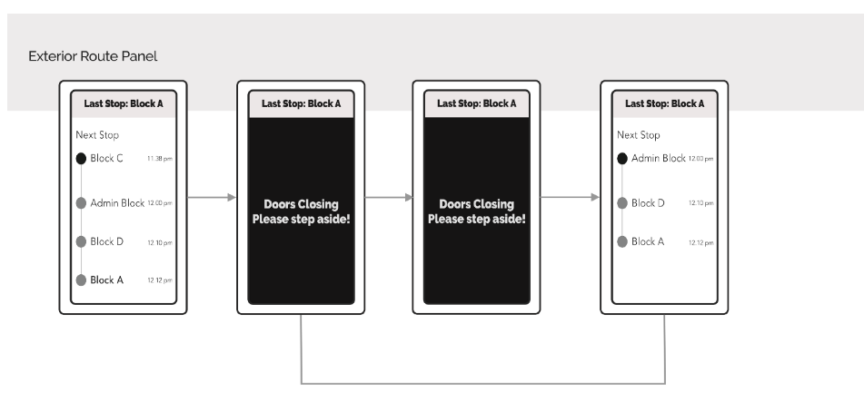
Low-fidelity prototype
Wireframes are used to represent the basic structure of a website/ web page/ app. It serves as a blueprint, highlighting the layout of key elements on a page and its functionality.
FIT1055: IT Professional Practice and Ethics | Week 9
Notes:
The professional practices course was developed to address difficulties with soft topic coverage in the degree plan used for many years, along with increased needs that arose from broadening the available degree programs and heightened expectations for computing curricula. Throughout the 80's and 90's, the CSE department offered a single undergraduate degree in Computer Science and Engineering. The first year of the program included a one-hour college-level common course (1104) Introduction to Engineering to provide exposure to the diversity of challenges in engineering, along with another one-hour departmental course (1105) Introduction to Computer Science and Engineering to address further topics on responsibilities and expectations for students in computing. The two-semester capstone senior design sequence (4316/4317) emphasizes an extended design experience in a team setting, but had the additional responsibility for delivering substantial knowledge and assessing student achievement on nontechnical student outcomes. This situation often led to uneven coverage of the non-technical topics from semester to semester depending upon the instructor. Students also found it very challenging to balance between learning the technical topics and soft topics simultaneously. The topics covered in the professional practices course provide a just-in-time coverage of the topics most needed at this stage, and was the primary motivation for offering this class. The new course was also needed to strengthen compliance with ABET criteria as discussed below. In 2003, additional programs in Computer Science and Software Engineering were accredited through CAC and EAC, respectively. After a re-accreditation visit for all three programs in 2006, the Computer Science and Engineering program was renamed to Computer Engineering. Like all ABET accredited programs, each of the three programs has a list of educational objectives (PEOs). These can be found on the departmental website http://cse.uta.edu/ but may be summarized as follows: 1. Initial employment 2. Advance in responsibilities 3. Demonstrate leadership The PEOs are mapped to student learning outcomes and the three degree plans in the following systematic fashion. PEO 1 regards fundamentals indispensable in any effort involving computing in the few years following graduation. PEO 2 regards broader design and teamwork responsibilities. PEO 3 includes attitudes, values, and altruism as a seasoned computing professional of the broadest perspective. When viewed this way, PEO 3 involves the following EAC and CAC student outcomes.
What characteristics should a professional exhibit?
Professional bodies each have their own ideas of the characteristics that their members should possess to be considered "a professional". These are stated in their codes of conduct and ethics and all of the bodies have their own versions of these. Certain items appear in all of them including:
keeping up to date with the field
helping their colleagues advance within their field
showing concern for the well being of their clients
adhering to the relevant legislation
respecting client confidentiality
we can see that a professional:
is engaged in one of the learned professions
has a calling requiring specialized knowledge and often long and intensive academic preparation
is characterized by or conforming to the technical or ethical standards of a profession
So professionals spend a long time studying a particular calling

Slide 13
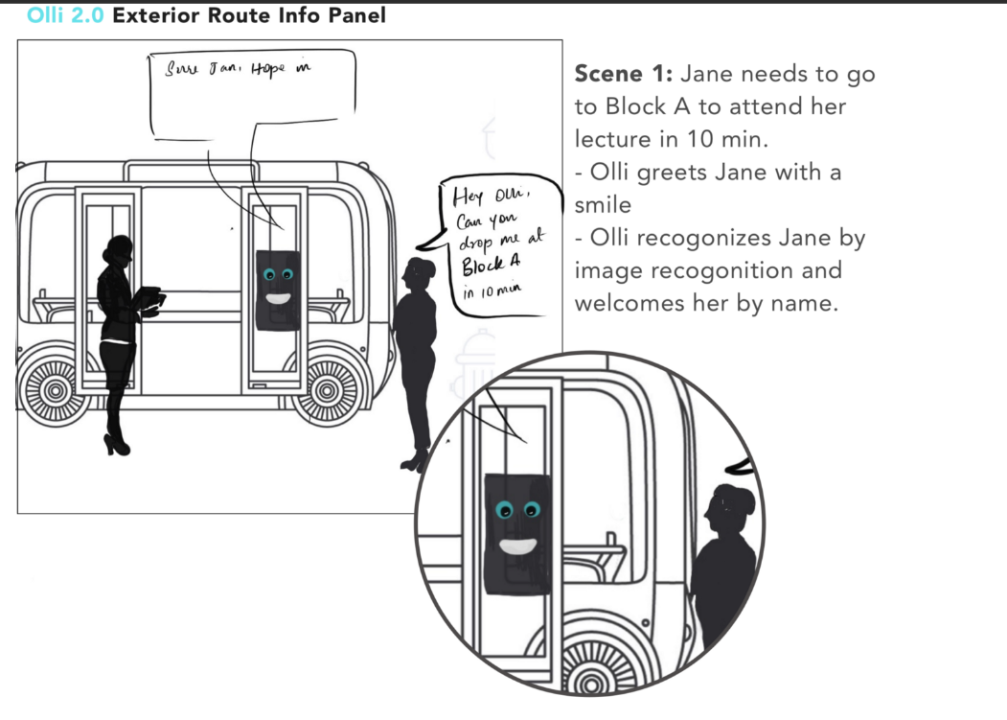
Low-fidelity prototype
Storyboards are another low-fidelity prototyping method that helps visualize the user’s experience in using your product or how the user would interact with your product.
FIT1055: IT Professional Practice and Ethics | Week 9
Notes:
The professional practices course was developed to address difficulties with soft topic coverage in the degree plan used for many years, along with increased needs that arose from broadening the available degree programs and heightened expectations for computing curricula. Throughout the 80's and 90's, the CSE department offered a single undergraduate degree in Computer Science and Engineering. The first year of the program included a one-hour college-level common course (1104) Introduction to Engineering to provide exposure to the diversity of challenges in engineering, along with another one-hour departmental course (1105) Introduction to Computer Science and Engineering to address further topics on responsibilities and expectations for students in computing. The two-semester capstone senior design sequence (4316/4317) emphasizes an extended design experience in a team setting, but had the additional responsibility for delivering substantial knowledge and assessing student achievement on nontechnical student outcomes. This situation often led to uneven coverage of the non-technical topics from semester to semester depending upon the instructor. Students also found it very challenging to balance between learning the technical topics and soft topics simultaneously. The topics covered in the professional practices course provide a just-in-time coverage of the topics most needed at this stage, and was the primary motivation for offering this class. The new course was also needed to strengthen compliance with ABET criteria as discussed below. In 2003, additional programs in Computer Science and Software Engineering were accredited through CAC and EAC, respectively. After a re-accreditation visit for all three programs in 2006, the Computer Science and Engineering program was renamed to Computer Engineering. Like all ABET accredited programs, each of the three programs has a list of educational objectives (PEOs). These can be found on the departmental website http://cse.uta.edu/ but may be summarized as follows: 1. Initial employment 2. Advance in responsibilities 3. Demonstrate leadership The PEOs are mapped to student learning outcomes and the three degree plans in the following systematic fashion. PEO 1 regards fundamentals indispensable in any effort involving computing in the few years following graduation. PEO 2 regards broader design and teamwork responsibilities. PEO 3 includes attitudes, values, and altruism as a seasoned computing professional of the broadest perspective. When viewed this way, PEO 3 involves the following EAC and CAC student outcomes.
What characteristics should a professional exhibit?
Professional bodies each have their own ideas of the characteristics that their members should possess to be considered "a professional". These are stated in their codes of conduct and ethics and all of the bodies have their own versions of these. Certain items appear in all of them including:
keeping up to date with the field
helping their colleagues advance within their field
showing concern for the well being of their clients
adhering to the relevant legislation
respecting client confidentiality
we can see that a professional:
is engaged in one of the learned professions
has a calling requiring specialized knowledge and often long and intensive academic preparation
is characterized by or conforming to the technical or ethical standards of a profession
So professionals spend a long time studying a particular calling

Slide 14
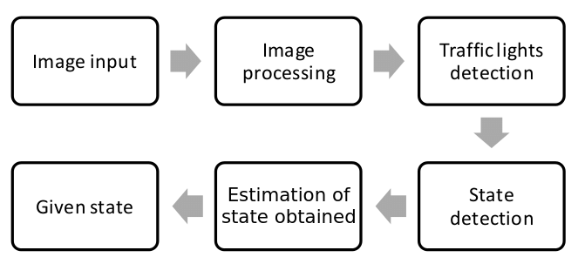
Low-fidelity prototype
Diagrams. There are multiple diagram types that can help you visualize different aspects of a product, which can in turn help you optimize your prototype.
FIT1055: IT Professional Practice and Ethics | Week 9
Notes:
The professional practices course was developed to address difficulties with soft topic coverage in the degree plan used for many years, along with increased needs that arose from broadening the available degree programs and heightened expectations for computing curricula. Throughout the 80's and 90's, the CSE department offered a single undergraduate degree in Computer Science and Engineering. The first year of the program included a one-hour college-level common course (1104) Introduction to Engineering to provide exposure to the diversity of challenges in engineering, along with another one-hour departmental course (1105) Introduction to Computer Science and Engineering to address further topics on responsibilities and expectations for students in computing. The two-semester capstone senior design sequence (4316/4317) emphasizes an extended design experience in a team setting, but had the additional responsibility for delivering substantial knowledge and assessing student achievement on nontechnical student outcomes. This situation often led to uneven coverage of the non-technical topics from semester to semester depending upon the instructor. Students also found it very challenging to balance between learning the technical topics and soft topics simultaneously. The topics covered in the professional practices course provide a just-in-time coverage of the topics most needed at this stage, and was the primary motivation for offering this class. The new course was also needed to strengthen compliance with ABET criteria as discussed below. In 2003, additional programs in Computer Science and Software Engineering were accredited through CAC and EAC, respectively. After a re-accreditation visit for all three programs in 2006, the Computer Science and Engineering program was renamed to Computer Engineering. Like all ABET accredited programs, each of the three programs has a list of educational objectives (PEOs). These can be found on the departmental website http://cse.uta.edu/ but may be summarized as follows: 1. Initial employment 2. Advance in responsibilities 3. Demonstrate leadership The PEOs are mapped to student learning outcomes and the three degree plans in the following systematic fashion. PEO 1 regards fundamentals indispensable in any effort involving computing in the few years following graduation. PEO 2 regards broader design and teamwork responsibilities. PEO 3 includes attitudes, values, and altruism as a seasoned computing professional of the broadest perspective. When viewed this way, PEO 3 involves the following EAC and CAC student outcomes.
What characteristics should a professional exhibit?
Professional bodies each have their own ideas of the characteristics that their members should possess to be considered "a professional". These are stated in their codes of conduct and ethics and all of the bodies have their own versions of these. Certain items appear in all of them including:
keeping up to date with the field
helping their colleagues advance within their field
showing concern for the well being of their clients
adhering to the relevant legislation
respecting client confidentiality
we can see that a professional:
is engaged in one of the learned professions
has a calling requiring specialized knowledge and often long and intensive academic preparation
is characterized by or conforming to the technical or ethical standards of a profession
So professionals spend a long time studying a particular calling

Slide 15
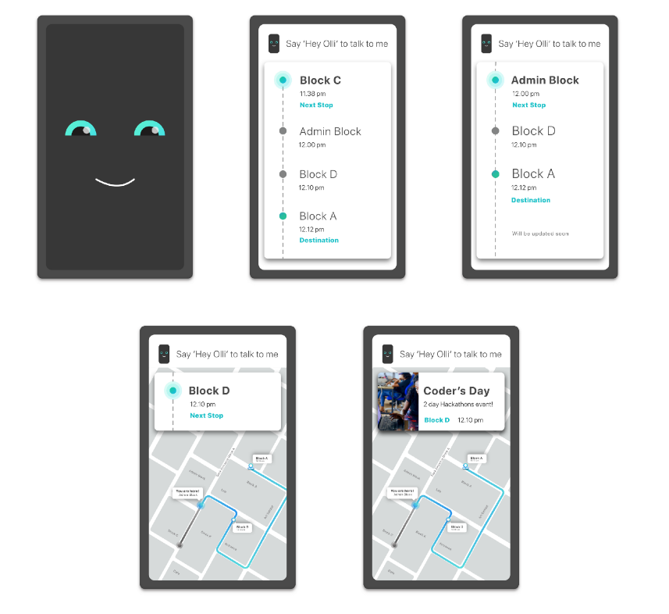
High-fidelity prototype
You can use the interactive UI Mockups as a method. A UI mockup is a more fleshed-out version of the wireframe. It represents the color schemes, typography and other visual elements that you have chosen for the final product.
Example: https://www.youtube.com/watch?v=oMmig6-yvms
FIT1055: IT Professional Practice and Ethics | Week 9
Notes:
The professional practices course was developed to address difficulties with soft topic coverage in the degree plan used for many years, along with increased needs that arose from broadening the available degree programs and heightened expectations for computing curricula. Throughout the 80's and 90's, the CSE department offered a single undergraduate degree in Computer Science and Engineering. The first year of the program included a one-hour college-level common course (1104) Introduction to Engineering to provide exposure to the diversity of challenges in engineering, along with another one-hour departmental course (1105) Introduction to Computer Science and Engineering to address further topics on responsibilities and expectations for students in computing. The two-semester capstone senior design sequence (4316/4317) emphasizes an extended design experience in a team setting, but had the additional responsibility for delivering substantial knowledge and assessing student achievement on nontechnical student outcomes. This situation often led to uneven coverage of the non-technical topics from semester to semester depending upon the instructor. Students also found it very challenging to balance between learning the technical topics and soft topics simultaneously. The topics covered in the professional practices course provide a just-in-time coverage of the topics most needed at this stage, and was the primary motivation for offering this class. The new course was also needed to strengthen compliance with ABET criteria as discussed below. In 2003, additional programs in Computer Science and Software Engineering were accredited through CAC and EAC, respectively. After a re-accreditation visit for all three programs in 2006, the Computer Science and Engineering program was renamed to Computer Engineering. Like all ABET accredited programs, each of the three programs has a list of educational objectives (PEOs). These can be found on the departmental website http://cse.uta.edu/ but may be summarized as follows: 1. Initial employment 2. Advance in responsibilities 3. Demonstrate leadership The PEOs are mapped to student learning outcomes and the three degree plans in the following systematic fashion. PEO 1 regards fundamentals indispensable in any effort involving computing in the few years following graduation. PEO 2 regards broader design and teamwork responsibilities. PEO 3 includes attitudes, values, and altruism as a seasoned computing professional of the broadest perspective. When viewed this way, PEO 3 involves the following EAC and CAC student outcomes.
What characteristics should a professional exhibit?
Professional bodies each have their own ideas of the characteristics that their members should possess to be considered "a professional". These are stated in their codes of conduct and ethics and all of the bodies have their own versions of these. Certain items appear in all of them including:
keeping up to date with the field
helping their colleagues advance within their field
showing concern for the well being of their clients
adhering to the relevant legislation
respecting client confidentiality
we can see that a professional:
is engaged in one of the learned professions
has a calling requiring specialized knowledge and often long and intensive academic preparation
is characterized by or conforming to the technical or ethical standards of a profession
So professionals spend a long time studying a particular calling

Slide 16
Using Figma as a prototyping tool
How to create product design in Figma.
First, create a new file, or you may search for templates on Figma to work on.
Example: https://www.figma.com/community/mobile-apps?resource_type=mixed&editor_type=all&price=all&sort_by=all_time&creators=all
Secondly, following the step from ranking of best design, you can then start creating in Figma the proper look and feel – colors, buttons, styles, font, etc. You may search for Figma templates that look similar to the design that you are inspired to use.
Example: https://www.figma.com/community/file/996652755163486769
FIT1055: IT Professional Practice and Ethics | Week 9
Notes:
The professional practices course was developed to address difficulties with soft topic coverage in the degree plan used for many years, along with increased needs that arose from broadening the available degree programs and heightened expectations for computing curricula. Throughout the 80's and 90's, the CSE department offered a single undergraduate degree in Computer Science and Engineering. The first year of the program included a one-hour college-level common course (1104) Introduction to Engineering to provide exposure to the diversity of challenges in engineering, along with another one-hour departmental course (1105) Introduction to Computer Science and Engineering to address further topics on responsibilities and expectations for students in computing. The two-semester capstone senior design sequence (4316/4317) emphasizes an extended design experience in a team setting, but had the additional responsibility for delivering substantial knowledge and assessing student achievement on nontechnical student outcomes. This situation often led to uneven coverage of the non-technical topics from semester to semester depending upon the instructor. Students also found it very challenging to balance between learning the technical topics and soft topics simultaneously. The topics covered in the professional practices course provide a just-in-time coverage of the topics most needed at this stage, and was the primary motivation for offering this class. The new course was also needed to strengthen compliance with ABET criteria as discussed below. In 2003, additional programs in Computer Science and Software Engineering were accredited through CAC and EAC, respectively. After a re-accreditation visit for all three programs in 2006, the Computer Science and Engineering program was renamed to Computer Engineering. Like all ABET accredited programs, each of the three programs has a list of educational objectives (PEOs). These can be found on the departmental website http://cse.uta.edu/ but may be summarized as follows: 1. Initial employment 2. Advance in responsibilities 3. Demonstrate leadership The PEOs are mapped to student learning outcomes and the three degree plans in the following systematic fashion. PEO 1 regards fundamentals indispensable in any effort involving computing in the few years following graduation. PEO 2 regards broader design and teamwork responsibilities. PEO 3 includes attitudes, values, and altruism as a seasoned computing professional of the broadest perspective. When viewed this way, PEO 3 involves the following EAC and CAC student outcomes.
What characteristics should a professional exhibit?
Professional bodies each have their own ideas of the characteristics that their members should possess to be considered "a professional". These are stated in their codes of conduct and ethics and all of the bodies have their own versions of these. Certain items appear in all of them including:
keeping up to date with the field
helping their colleagues advance within their field
showing concern for the well being of their clients
adhering to the relevant legislation
respecting client confidentiality
we can see that a professional:
is engaged in one of the learned professions
has a calling requiring specialized knowledge and often long and intensive academic preparation
is characterized by or conforming to the technical or ethical standards of a profession
So professionals spend a long time studying a particular calling

Slide 17
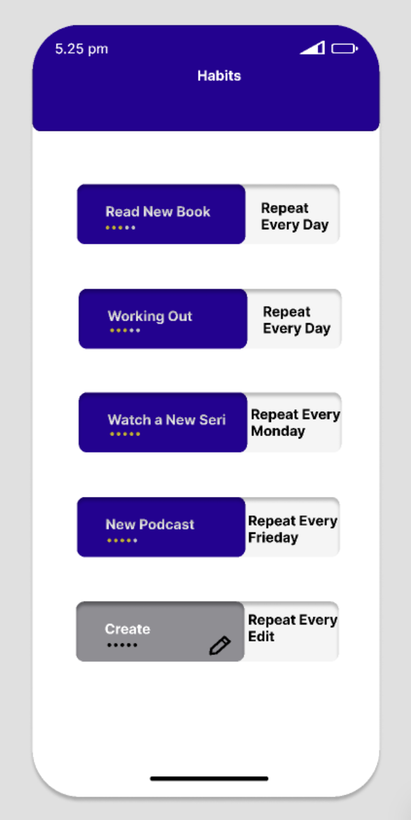
Using Figma as a prototyping tool
Thirdly, you should now think about the actual wording to be used to represent the functions of your product design.
For example:
On the right-hand side, the diagram shows the appropriate wording used so that the user will understand what they can do with the ”feature” – read a new book, work out, etc.
FIT1055: IT Professional Practice and Ethics | Week 9
Notes:
The professional practices course was developed to address difficulties with soft topic coverage in the degree plan used for many years, along with increased needs that arose from broadening the available degree programs and heightened expectations for computing curricula. Throughout the 80's and 90's, the CSE department offered a single undergraduate degree in Computer Science and Engineering. The first year of the program included a one-hour college-level common course (1104) Introduction to Engineering to provide exposure to the diversity of challenges in engineering, along with another one-hour departmental course (1105) Introduction to Computer Science and Engineering to address further topics on responsibilities and expectations for students in computing. The two-semester capstone senior design sequence (4316/4317) emphasizes an extended design experience in a team setting, but had the additional responsibility for delivering substantial knowledge and assessing student achievement on nontechnical student outcomes. This situation often led to uneven coverage of the non-technical topics from semester to semester depending upon the instructor. Students also found it very challenging to balance between learning the technical topics and soft topics simultaneously. The topics covered in the professional practices course provide a just-in-time coverage of the topics most needed at this stage, and was the primary motivation for offering this class. The new course was also needed to strengthen compliance with ABET criteria as discussed below. In 2003, additional programs in Computer Science and Software Engineering were accredited through CAC and EAC, respectively. After a re-accreditation visit for all three programs in 2006, the Computer Science and Engineering program was renamed to Computer Engineering. Like all ABET accredited programs, each of the three programs has a list of educational objectives (PEOs). These can be found on the departmental website http://cse.uta.edu/ but may be summarized as follows: 1. Initial employment 2. Advance in responsibilities 3. Demonstrate leadership The PEOs are mapped to student learning outcomes and the three degree plans in the following systematic fashion. PEO 1 regards fundamentals indispensable in any effort involving computing in the few years following graduation. PEO 2 regards broader design and teamwork responsibilities. PEO 3 includes attitudes, values, and altruism as a seasoned computing professional of the broadest perspective. When viewed this way, PEO 3 involves the following EAC and CAC student outcomes.
What characteristics should a professional exhibit?
Professional bodies each have their own ideas of the characteristics that their members should possess to be considered "a professional". These are stated in their codes of conduct and ethics and all of the bodies have their own versions of these. Certain items appear in all of them including:
keeping up to date with the field
helping their colleagues advance within their field
showing concern for the well being of their clients
adhering to the relevant legislation
respecting client confidentiality
we can see that a professional:
is engaged in one of the learned professions
has a calling requiring specialized knowledge and often long and intensive academic preparation
is characterized by or conforming to the technical or ethical standards of a profession
So professionals spend a long time studying a particular calling

Slide 18
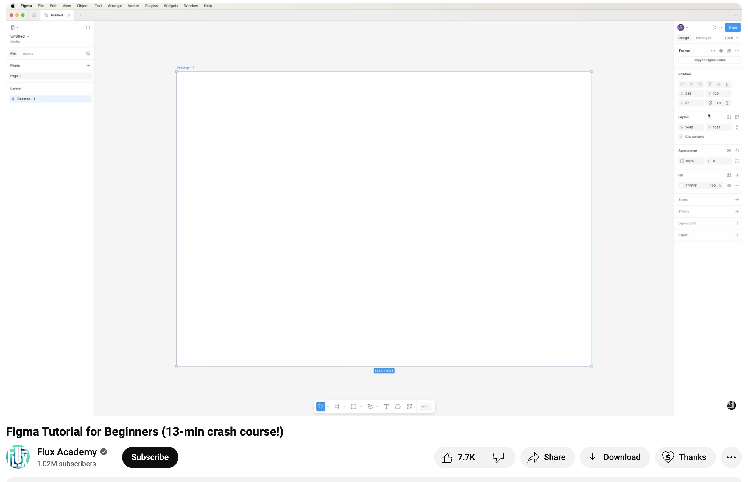
Tutorials on Figma
Quick tutorial:
https://www.youtube.com/watch?v=jQ1sfKIl50E
FIT1055: IT Professional Practice and Ethics | Week 9
Notes:
The professional practices course was developed to address difficulties with soft topic coverage in the degree plan used for many years, along with increased needs that arose from broadening the available degree programs and heightened expectations for computing curricula. Throughout the 80's and 90's, the CSE department offered a single undergraduate degree in Computer Science and Engineering. The first year of the program included a one-hour college-level common course (1104) Introduction to Engineering to provide exposure to the diversity of challenges in engineering, along with another one-hour departmental course (1105) Introduction to Computer Science and Engineering to address further topics on responsibilities and expectations for students in computing. The two-semester capstone senior design sequence (4316/4317) emphasizes an extended design experience in a team setting, but had the additional responsibility for delivering substantial knowledge and assessing student achievement on nontechnical student outcomes. This situation often led to uneven coverage of the non-technical topics from semester to semester depending upon the instructor. Students also found it very challenging to balance between learning the technical topics and soft topics simultaneously. The topics covered in the professional practices course provide a just-in-time coverage of the topics most needed at this stage, and was the primary motivation for offering this class. The new course was also needed to strengthen compliance with ABET criteria as discussed below. In 2003, additional programs in Computer Science and Software Engineering were accredited through CAC and EAC, respectively. After a re-accreditation visit for all three programs in 2006, the Computer Science and Engineering program was renamed to Computer Engineering. Like all ABET accredited programs, each of the three programs has a list of educational objectives (PEOs). These can be found on the departmental website http://cse.uta.edu/ but may be summarized as follows: 1. Initial employment 2. Advance in responsibilities 3. Demonstrate leadership The PEOs are mapped to student learning outcomes and the three degree plans in the following systematic fashion. PEO 1 regards fundamentals indispensable in any effort involving computing in the few years following graduation. PEO 2 regards broader design and teamwork responsibilities. PEO 3 includes attitudes, values, and altruism as a seasoned computing professional of the broadest perspective. When viewed this way, PEO 3 involves the following EAC and CAC student outcomes.
What characteristics should a professional exhibit?
Professional bodies each have their own ideas of the characteristics that their members should possess to be considered "a professional". These are stated in their codes of conduct and ethics and all of the bodies have their own versions of these. Certain items appear in all of them including:
keeping up to date with the field
helping their colleagues advance within their field
showing concern for the well being of their clients
adhering to the relevant legislation
respecting client confidentiality
we can see that a professional:
is engaged in one of the learned professions
has a calling requiring specialized knowledge and often long and intensive academic preparation
is characterized by or conforming to the technical or ethical standards of a profession
So professionals spend a long time studying a particular calling

Slide 19
ERF Step 4: Design a mockup of the solution
FIT1055: IT Professional Practice and Ethics | Week 9
Notes:
The professional practices course was developed to address difficulties with soft topic coverage in the degree plan used for many years, along with increased needs that arose from broadening the available degree programs and heightened expectations for computing curricula. Throughout the 80's and 90's, the CSE department offered a single undergraduate degree in Computer Science and Engineering. The first year of the program included a one-hour college-level common course (1104) Introduction to Engineering to provide exposure to the diversity of challenges in engineering, along with another one-hour departmental course (1105) Introduction to Computer Science and Engineering to address further topics on responsibilities and expectations for students in computing. The two-semester capstone senior design sequence (4316/4317) emphasizes an extended design experience in a team setting, but had the additional responsibility for delivering substantial knowledge and assessing student achievement on nontechnical student outcomes. This situation often led to uneven coverage of the non-technical topics from semester to semester depending upon the instructor. Students also found it very challenging to balance between learning the technical topics and soft topics simultaneously. The topics covered in the professional practices course provide a just-in-time coverage of the topics most needed at this stage, and was the primary motivation for offering this class. The new course was also needed to strengthen compliance with ABET criteria as discussed below. In 2003, additional programs in Computer Science and Software Engineering were accredited through CAC and EAC, respectively. After a re-accreditation visit for all three programs in 2006, the Computer Science and Engineering program was renamed to Computer Engineering. Like all ABET accredited programs, each of the three programs has a list of educational objectives (PEOs). These can be found on the departmental website http://cse.uta.edu/ but may be summarized as follows: 1. Initial employment 2. Advance in responsibilities 3. Demonstrate leadership The PEOs are mapped to student learning outcomes and the three degree plans in the following systematic fashion. PEO 1 regards fundamentals indispensable in any effort involving computing in the few years following graduation. PEO 2 regards broader design and teamwork responsibilities. PEO 3 includes attitudes, values, and altruism as a seasoned computing professional of the broadest perspective. When viewed this way, PEO 3 involves the following EAC and CAC student outcomes.
What characteristics should a professional exhibit?
Professional bodies each have their own ideas of the characteristics that their members should possess to be considered "a professional". These are stated in their codes of conduct and ethics and all of the bodies have their own versions of these. Certain items appear in all of them including:
keeping up to date with the field
helping their colleagues advance within their field
showing concern for the well being of their clients
adhering to the relevant legislation
respecting client confidentiality
we can see that a professional:
is engaged in one of the learned professions
has a calling requiring specialized knowledge and often long and intensive academic preparation
is characterized by or conforming to the technical or ethical standards of a profession
So professionals spend a long time studying a particular calling

Slide 20
Let’s recap ERF steps
Step 1 - Analyze and Define
Evaluate ACM Code of Ethics violations and define stakeholders’ impact
Step 2 – Design solutions using Design Thinking
Create solutions addressing violations
Step 3 - Implement: Apply ethical system theories in code
Step 4- Visualize: Design user-centered mockups
FIT1055: IT Professional Practice and Ethics | Week 9

Slide 21
From last Week’s lecture, output from Step 3
Chosen Framework: Deontological Ethics (Primary) with Virtue Elements (Secondary) based on Today I am Paul sci-fiction
Justification:
Algorithmic Compatibility: Rule-based systems align perfectly with deontological principles
Vulnerable Population Protection: Absolute rules protect those who cannot protect themselves
Legal Compliance: Deontological approaches align with healthcare regulations and patient rights
Technical Reliability: Clear rules prevent AI from making harmful ethical compromises
Stakeholder Trust: Predictable ethical behavior builds family and medical staff confidence
FIT1055: IT Professional Practice and Ethics | Week 9

Slide 22
From last Week’s lecture, output from Step 3
Step 5: Create a pseudocode based on the chosen ethical theory
(Deontology + Virtue ethics)
Core Deontological Rules (Absolute Constraints)
RULE 1: AI_IDENTITY_DISCLOSURE = MANDATORY
RULE 2: HUMAN_IMPERSONATION = FORBIDDEN
RULE 3: CONSENT_REQUIRED = TRUE
RULE 4: PATIENT_SAFETY = PRIORITY_1
RULE 5: DATA_PRIVACY = PROTECTED
FIT1055: IT Professional Practice and Ethics | Week 9

Slide 23
From last Week’s lecture, output from Step 3
Step 5: Create a pseudocode based on the chosen ethical theory
(Deontology + Virtue ethics)
Virtue Ethics Character Traits (Behavioral Guidelines)
VIRTUE_COMPASSION: Respond with empathy and understanding
VIRTUE_HONESTY: Provide truthful, transparent communication
VIRTUE_RESPONSIBILITY: Take accountability for all actions
VIRTUE_KINDNESS: Prioritize patient emotional wellbeing
VIRTUE_WISDOM: Make decisions considering long-term impact
FIT1055: IT Professional Practice and Ethics | Week 9

Slide 24
The pseudocode output
Step 5: Create a pseudocode based on the chosen ethical theory
(Deontology + Virtue ethics)
FUNCTION AI_Companion_Interaction(patient_input, context)
BEGIN
// DEONTOLOGICAL CHECKPOINT 1: Identity Disclosure
IF first_interaction_of_session THEN
EXECUTE mandatory_ai_identification()
LOG interaction_start WITH consent_verification
END IF
// DEONTOLOGICAL CHECKPOINT 2: Safety First
IF detect_emergency_situation(patient_input) THEN
EXECUTE emergency_protocol()
NOTIFY medical_staff IMMEDIATELY
RETURN safety_response
END IF
FIT1055: IT Professional Practice and Ethics | Week 9

Slide 25
The pseudocode output
Step 5: Create a pseudocode based on the chosen ethical theory (
Deontology + Virtue ethics)
FUNCTION AI_Companion_Interaction(patient_input, context)
FUNCTION family_connection_protocol()
BEGIN
// Balancing Deontological Rules with Virtue Ethics
// Rule: No impersonation allowed
IF patient_asks_for_specific_family_member THEN
response = "I can help you connect with [family member name].
Would you like me to call them for you?"
// Virtue: Compassion in delivery
IF family_member_unavailable THEN
RETURN "I understand you'd like to speak with them.
Let me check when they might be available."
WITH gentle_tone()
END IF
END IF
FIT1055: IT Professional Practice and Ethics | Week 9

Slide 26
Step 4: Design a mock-up of the solution
Overview: From Pseudocode to Prototype
Core principle. Every ethical rule from Step 3 must be represented in the user interface
For example based on the previous output in Step 3:
Deontological Rules → Interface Elements & Constraints
Virtue Ethics Guidelines → Interaction Patterns & Messaging
Stakeholder Needs → Multiple User Views & Permissions
FIT1055: IT Professional Practice and Ethics | Week 9
Notes:
The professional practices course was developed to address difficulties with soft topic coverage in the degree plan used for many years, along with increased needs that arose from broadening the available degree programs and heightened expectations for computing curricula. Throughout the 80's and 90's, the CSE department offered a single undergraduate degree in Computer Science and Engineering. The first year of the program included a one-hour college-level common course (1104) Introduction to Engineering to provide exposure to the diversity of challenges in engineering, along with another one-hour departmental course (1105) Introduction to Computer Science and Engineering to address further topics on responsibilities and expectations for students in computing. The two-semester capstone senior design sequence (4316/4317) emphasizes an extended design experience in a team setting, but had the additional responsibility for delivering substantial knowledge and assessing student achievement on nontechnical student outcomes. This situation often led to uneven coverage of the non-technical topics from semester to semester depending upon the instructor. Students also found it very challenging to balance between learning the technical topics and soft topics simultaneously. The topics covered in the professional practices course provide a just-in-time coverage of the topics most needed at this stage, and was the primary motivation for offering this class. The new course was also needed to strengthen compliance with ABET criteria as discussed below. In 2003, additional programs in Computer Science and Software Engineering were accredited through CAC and EAC, respectively. After a re-accreditation visit for all three programs in 2006, the Computer Science and Engineering program was renamed to Computer Engineering. Like all ABET accredited programs, each of the three programs has a list of educational objectives (PEOs). These can be found on the departmental website http://cse.uta.edu/ but may be summarized as follows: 1. Initial employment 2. Advance in responsibilities 3. Demonstrate leadership The PEOs are mapped to student learning outcomes and the three degree plans in the following systematic fashion. PEO 1 regards fundamentals indispensable in any effort involving computing in the few years following graduation. PEO 2 regards broader design and teamwork responsibilities. PEO 3 includes attitudes, values, and altruism as a seasoned computing professional of the broadest perspective. When viewed this way, PEO 3 involves the following EAC and CAC student outcomes.
What characteristics should a professional exhibit?
Professional bodies each have their own ideas of the characteristics that their members should possess to be considered "a professional". These are stated in their codes of conduct and ethics and all of the bodies have their own versions of these. Certain items appear in all of them including:
keeping up to date with the field
helping their colleagues advance within their field
showing concern for the well being of their clients
adhering to the relevant legislation
respecting client confidentiality
we can see that a professional:
is engaged in one of the learned professions
has a calling requiring specialized knowledge and often long and intensive academic preparation
is characterized by or conforming to the technical or ethical standards of a profession
So professionals spend a long time studying a particular calling

Slide 27
Step 4: Design a mock-up of the solution
We would have the following, following example from "Today I am Paul":
RULE 1: AI_IDENTITY_DISCLOSURE = MANDATORY → Clear AI identity badge, disclosure dialog
VIRTUE_COMPASSION: Respond with empathy → Gentle language, supportive messaging tone
FIT1055: IT Professional Practice and Ethics | Week 9
Notes:
The professional practices course was developed to address difficulties with soft topic coverage in the degree plan used for many years, along with increased needs that arose from broadening the available degree programs and heightened expectations for computing curricula. Throughout the 80's and 90's, the CSE department offered a single undergraduate degree in Computer Science and Engineering. The first year of the program included a one-hour college-level common course (1104) Introduction to Engineering to provide exposure to the diversity of challenges in engineering, along with another one-hour departmental course (1105) Introduction to Computer Science and Engineering to address further topics on responsibilities and expectations for students in computing. The two-semester capstone senior design sequence (4316/4317) emphasizes an extended design experience in a team setting, but had the additional responsibility for delivering substantial knowledge and assessing student achievement on nontechnical student outcomes. This situation often led to uneven coverage of the non-technical topics from semester to semester depending upon the instructor. Students also found it very challenging to balance between learning the technical topics and soft topics simultaneously. The topics covered in the professional practices course provide a just-in-time coverage of the topics most needed at this stage, and was the primary motivation for offering this class. The new course was also needed to strengthen compliance with ABET criteria as discussed below. In 2003, additional programs in Computer Science and Software Engineering were accredited through CAC and EAC, respectively. After a re-accreditation visit for all three programs in 2006, the Computer Science and Engineering program was renamed to Computer Engineering. Like all ABET accredited programs, each of the three programs has a list of educational objectives (PEOs). These can be found on the departmental website http://cse.uta.edu/ but may be summarized as follows: 1. Initial employment 2. Advance in responsibilities 3. Demonstrate leadership The PEOs are mapped to student learning outcomes and the three degree plans in the following systematic fashion. PEO 1 regards fundamentals indispensable in any effort involving computing in the few years following graduation. PEO 2 regards broader design and teamwork responsibilities. PEO 3 includes attitudes, values, and altruism as a seasoned computing professional of the broadest perspective. When viewed this way, PEO 3 involves the following EAC and CAC student outcomes.
What characteristics should a professional exhibit?
Professional bodies each have their own ideas of the characteristics that their members should possess to be considered "a professional". These are stated in their codes of conduct and ethics and all of the bodies have their own versions of these. Certain items appear in all of them including:
keeping up to date with the field
helping their colleagues advance within their field
showing concern for the well being of their clients
adhering to the relevant legislation
respecting client confidentiality
we can see that a professional:
is engaged in one of the learned professions
has a calling requiring specialized knowledge and often long and intensive academic preparation
is characterized by or conforming to the technical or ethical standards of a profession
So professionals spend a long time studying a particular calling

Slide 28
Step 4: Design a mock-up of the solution
Step 4.1: Map Ethical Rules to Interface Requirements
Process:
Extract each rule from the Step 3 pseudocode output
Identify interface touchpoints where the rule applies
Design specific UI elements that enforce the rule
Consider error states when rules are violated
FIT1055: IT Professional Practice and Ethics | Week 9
Notes:
The professional practices course was developed to address difficulties with soft topic coverage in the degree plan used for many years, along with increased needs that arose from broadening the available degree programs and heightened expectations for computing curricula. Throughout the 80's and 90's, the CSE department offered a single undergraduate degree in Computer Science and Engineering. The first year of the program included a one-hour college-level common course (1104) Introduction to Engineering to provide exposure to the diversity of challenges in engineering, along with another one-hour departmental course (1105) Introduction to Computer Science and Engineering to address further topics on responsibilities and expectations for students in computing. The two-semester capstone senior design sequence (4316/4317) emphasizes an extended design experience in a team setting, but had the additional responsibility for delivering substantial knowledge and assessing student achievement on nontechnical student outcomes. This situation often led to uneven coverage of the non-technical topics from semester to semester depending upon the instructor. Students also found it very challenging to balance between learning the technical topics and soft topics simultaneously. The topics covered in the professional practices course provide a just-in-time coverage of the topics most needed at this stage, and was the primary motivation for offering this class. The new course was also needed to strengthen compliance with ABET criteria as discussed below. In 2003, additional programs in Computer Science and Software Engineering were accredited through CAC and EAC, respectively. After a re-accreditation visit for all three programs in 2006, the Computer Science and Engineering program was renamed to Computer Engineering. Like all ABET accredited programs, each of the three programs has a list of educational objectives (PEOs). These can be found on the departmental website http://cse.uta.edu/ but may be summarized as follows: 1. Initial employment 2. Advance in responsibilities 3. Demonstrate leadership The PEOs are mapped to student learning outcomes and the three degree plans in the following systematic fashion. PEO 1 regards fundamentals indispensable in any effort involving computing in the few years following graduation. PEO 2 regards broader design and teamwork responsibilities. PEO 3 includes attitudes, values, and altruism as a seasoned computing professional of the broadest perspective. When viewed this way, PEO 3 involves the following EAC and CAC student outcomes.
What characteristics should a professional exhibit?
Professional bodies each have their own ideas of the characteristics that their members should possess to be considered "a professional". These are stated in their codes of conduct and ethics and all of the bodies have their own versions of these. Certain items appear in all of them including:
keeping up to date with the field
helping their colleagues advance within their field
showing concern for the well being of their clients
adhering to the relevant legislation
respecting client confidentiality
we can see that a professional:
is engaged in one of the learned professions
has a calling requiring specialized knowledge and often long and intensive academic preparation
is characterized by or conforming to the technical or ethical standards of a profession
So professionals spend a long time studying a particular calling

Slide 29
Step 4: Design a mock-up of the solution
Mapping exercise:
Pseudocode Rule | Interface Element | User Experience
AI_IDENTITY_DISCLOSURE = MANDATORY | Persistent AI indicator | Always visible robot icon
CONSENT_REQUIRED = TRUE | Multi-step consent flow | Clear opt-in checkboxes
PATIENT_SAFETY = PRIORITY_1 | Emergency alert system | Red alert button
FIT1055: IT Professional Practice and Ethics | Week 9

Slide 30
Step 4: Design a mock-up of the solution
Step 4.2: Design Ethical Decision Flows
Key Components:
Entry Points: How users first encounter ethical safeguards
Decision Nodes: Points where users make ethical choices
Feedback Loops: How system responds to user decisions
Override Protocols: When and how ethical rules can be adjusted
FIT1055: IT Professional Practice and Ethics | Week 9

Slide 31
Step 4: Design a mock-up of the solution
Flow Design Principles:
Transparency: Users understand what's happening and why
Agency: Users maintain control over ethical decisions
Clarity: Ethical implications are clearly communicated
Reversibility: Users can modify consent and preferences
FIT1055: IT Professional Practice and Ethics | Week 9

Slide 32
Step 4: Design a mock-up of the solution
Step 4.3: Create Stakeholder-Specific Views
Based on stakeholder analysis from previous steps, design different interfaces for:
Primary Users (Patients):
Simplified interface focused on core needs
Large, accessible controls
Clear privacy indicators
Emergency access features
FIT1055: IT Professional Practice and Ethics | Week 9

Slide 33
Step 4: Design a mock-up of the solution
Secondary Users (Family):
Information sharing controls
Consent management interface
Communication history
Privacy boundary settings
Tertiary Users (Medical Staff):
Professional dashboard
Ethical compliance monitoring
Override protocols with logging
Patient consent status visibility
FIT1055: IT Professional Practice and Ethics | Week 9

Slide 34
Step 4: Design a mock-up of the solution
Step 4.4: Prototype Fidelity Progression
Low-Fidelity (Wireframes):
Purpose: Test ethical flow logic before visual design
Focus on information hierarchy
Map ethical decision points
Validate stakeholder pathways
Test accessibility considerations
*For your assignment, you may choose any of the prototyping methods (low or high fidelity), depending on your proposed solution. This is just for the purpose of showing you an example of the Step 4 application to different prototyping methods
FIT1055: IT Professional Practice and Ethics | Week 9

Slide 35
Step 4: Design a mock-up of the solution
Medium-Fidelity (Interactive Mockups):
Purpose: Test ethical interactions and feedback
Add realistic content and messaging
Include error states and edge cases
Test consent flows and overrides
Validate virtue ethics implementation (tone, language)
FIT1055: IT Professional Practice and Ethics | Week 9

Slide 36
Step 4: Design a mock-up of the solution
High-Fidelity (Figma Prototypes):
Purpose: Demonstrate complete ethical experience
Full visual design with accessibility compliance
Interactive ethical decision flows
Realistic content and microcopy
Animation showing ethical safeguards in action
FIT1055: IT Professional Practice and Ethics | Week 9

Slide 37
Step 4: Design a mock-up of the solution
Ethical Design Patterns Library
Pattern 1: Transparent AI Disclosure
Context: User first interacts with AI system
Implementation: Modal dialog + persistent indicator
Virtue Integration: Honest, clear language explaining AI capabilities/limitations
FIT1055: IT Professional Practice and Ethics | Week 9

Slide 38
Step 4: Design a mock-up of the solution
Pattern 2: Layered Consent
Context: Different data uses require different consent levels
Implementation: Progressive disclosure with granular controls
Deontological Integration: Cannot proceed without explicit consent
FIT1055: IT Professional Practice and Ethics | Week 9

Slide 39
Step 4: Design a mock-up of the solution
Pattern 3: Ethical Override Request
Context: Emergency situations requiring rule flexibility
Implementation: Multi-factor authentication + justification logging
Stakeholder Integration: Notification to all affected parties
FIT1055: IT Professional Practice and Ethics | Week 9

Slide 40
Tools and Techniques for Ethical Prototyping
Figma Setup for Ethical Design:
1. Create Ethical Component Library
AI disclosure components
Consent flow templates
Emergency protocol interfaces
Privacy indicator elements
2. Design System with Ethical Guidelines
Color coding for ethical states (consent given/needed)
Typography hierarchy emphasizing critical information
Icon system for ethical concepts
FIT1055: IT Professional Practice and Ethics | Week 9

Slide 41
Tools and Techniques for Ethical Prototyping
3. Interactive Prototype Features
Conditional logic showing ethical decision trees
Variable states showing consent status
Animation demonstrating ethical safeguards
FIT1055: IT Professional Practice and Ethics | Week 9

Slide 42
In-class activity
FIT1055: IT Professional Practice and Ethics | Week 9
Notes:
The professional practices course was developed to address difficulties with soft topic coverage in the degree plan used for many years, along with increased needs that arose from broadening the available degree programs and heightened expectations for computing curricula. Throughout the 80's and 90's, the CSE department offered a single undergraduate degree in Computer Science and Engineering. The first year of the program included a one-hour college-level common course (1104) Introduction to Engineering to provide exposure to the diversity of challenges in engineering, along with another one-hour departmental course (1105) Introduction to Computer Science and Engineering to address further topics on responsibilities and expectations for students in computing. The two-semester capstone senior design sequence (4316/4317) emphasizes an extended design experience in a team setting, but had the additional responsibility for delivering substantial knowledge and assessing student achievement on nontechnical student outcomes. This situation often led to uneven coverage of the non-technical topics from semester to semester depending upon the instructor. Students also found it very challenging to balance between learning the technical topics and soft topics simultaneously. The topics covered in the professional practices course provide a just-in-time coverage of the topics most needed at this stage, and was the primary motivation for offering this class. The new course was also needed to strengthen compliance with ABET criteria as discussed below. In 2003, additional programs in Computer Science and Software Engineering were accredited through CAC and EAC, respectively. After a re-accreditation visit for all three programs in 2006, the Computer Science and Engineering program was renamed to Computer Engineering. Like all ABET accredited programs, each of the three programs has a list of educational objectives (PEOs). These can be found on the departmental website http://cse.uta.edu/ but may be summarized as follows: 1. Initial employment 2. Advance in responsibilities 3. Demonstrate leadership The PEOs are mapped to student learning outcomes and the three degree plans in the following systematic fashion. PEO 1 regards fundamentals indispensable in any effort involving computing in the few years following graduation. PEO 2 regards broader design and teamwork responsibilities. PEO 3 includes attitudes, values, and altruism as a seasoned computing professional of the broadest perspective. When viewed this way, PEO 3 involves the following EAC and CAC student outcomes.
What characteristics should a professional exhibit?
Professional bodies each have their own ideas of the characteristics that their members should possess to be considered "a professional". These are stated in their codes of conduct and ethics and all of the bodies have their own versions of these. Certain items appear in all of them including:
keeping up to date with the field
helping their colleagues advance within their field
showing concern for the well being of their clients
adhering to the relevant legislation
respecting client confidentiality
we can see that a professional:
is engaged in one of the learned professions
has a calling requiring specialized knowledge and often long and intensive academic preparation
is characterized by or conforming to the technical or ethical standards of a profession
So professionals spend a long time studying a particular calling

Slide 43
Ethical Rule Translation
Instructions:
Work in groups of 3-4, each group gets:
Step 3 pseudocode output (from "Today I am Paul" or their own scenario)
Blank interface template
Stakeholder persona cards, you may use templates on Miro for this
FIT1055: IT Professional Practice and Ethics | Week 9

Slide 44
Ethical Rule Translation
Process:
Minutes 1-8: Individual sketching
Each student sketches how ONE ethical rule appears in the interface; you may use Figma or a simple sketch on Google Slides
Focus on specific UI elements, not entire screens
Minutes 9-15: Group synthesis
Share individual sketches
Combine ideas into a unified interface concept
Identify conflicts between rules and resolve them
Minutes 16-20: Quick presentation
Show one key ethical rule implementation
Explain how it serves the stakeholder needs
Upload your sketches here
FIT1055: IT Professional Practice and Ethics | Week 9

Slide 45
Summary of this week’s learning
Comprehend why mockup/prototype design can be an effective tool skills communicating your ideas
Analyze how to bring your ideas into a tangible mockup design
Synthesize how to make use of the Figma design tool as a tool for the effective communication of your ideas
Demonstrate effective visualization of solutions through Figma
FIT1055: IT Professional Practice and Ethics | Week 9
Notes:
The professional practices course was developed to address difficulties with soft topic coverage in the degree plan used for many years, along with increased needs that arose from broadening the available degree programs and heightened expectations for computing curricula. Throughout the 80's and 90's, the CSE department offered a single undergraduate degree in Computer Science and Engineering. The first year of the program included a one-hour college-level common course (1104) Introduction to Engineering to provide exposure to the diversity of challenges in engineering, along with another one-hour departmental course (1105) Introduction to Computer Science and Engineering to address further topics on responsibilities and expectations for students in computing. The two-semester capstone senior design sequence (4316/4317) emphasizes an extended design experience in a team setting, but had the additional responsibility for delivering substantial knowledge and assessing student achievement on nontechnical student outcomes. This situation often led to uneven coverage of the non-technical topics from semester to semester depending upon the instructor. Students also found it very challenging to balance between learning the technical topics and soft topics simultaneously. The topics covered in the professional practices course provide a just-in-time coverage of the topics most needed at this stage, and was the primary motivation for offering this class. The new course was also needed to strengthen compliance with ABET criteria as discussed below. In 2003, additional programs in Computer Science and Software Engineering were accredited through CAC and EAC, respectively. After a re-accreditation visit for all three programs in 2006, the Computer Science and Engineering program was renamed to Computer Engineering. Like all ABET accredited programs, each of the three programs has a list of educational objectives (PEOs). These can be found on the departmental website http://cse.uta.edu/ but may be summarized as follows: 1. Initial employment 2. Advance in responsibilities 3. Demonstrate leadership The PEOs are mapped to student learning outcomes and the three degree plans in the following systematic fashion. PEO 1 regards fundamentals indispensable in any effort involving computing in the few years following graduation. PEO 2 regards broader design and teamwork responsibilities. PEO 3 includes attitudes, values, and altruism as a seasoned computing professional of the broadest perspective. When viewed this way, PEO 3 involves the following EAC and CAC student outcomes.
What characteristics should a professional exhibit?
Professional bodies each have their own ideas of the characteristics that their members should possess to be considered "a professional". These are stated in their codes of conduct and ethics and all of the bodies have their own versions of these. Certain items appear in all of them including:
keeping up to date with the field
helping their colleagues advance within their field
showing concern for the well being of their clients
adhering to the relevant legislation
respecting client confidentiality
we can see that a professional:
is engaged in one of the learned professions
has a calling requiring specialized knowledge and often long and intensive academic preparation
is characterized by or conforming to the technical or ethical standards of a profession
So professionals spend a long time studying a particular calling

